Slide 1
Li-Fi (Light Fidelity)
MEMBERS
m. Ammad Ul Hasan – 11189
Simra – 11278
Furqan -11304
Course: Data communication and networking
Class Id: 108959
Instructor: Sir Kashif Bashir

Slide 2
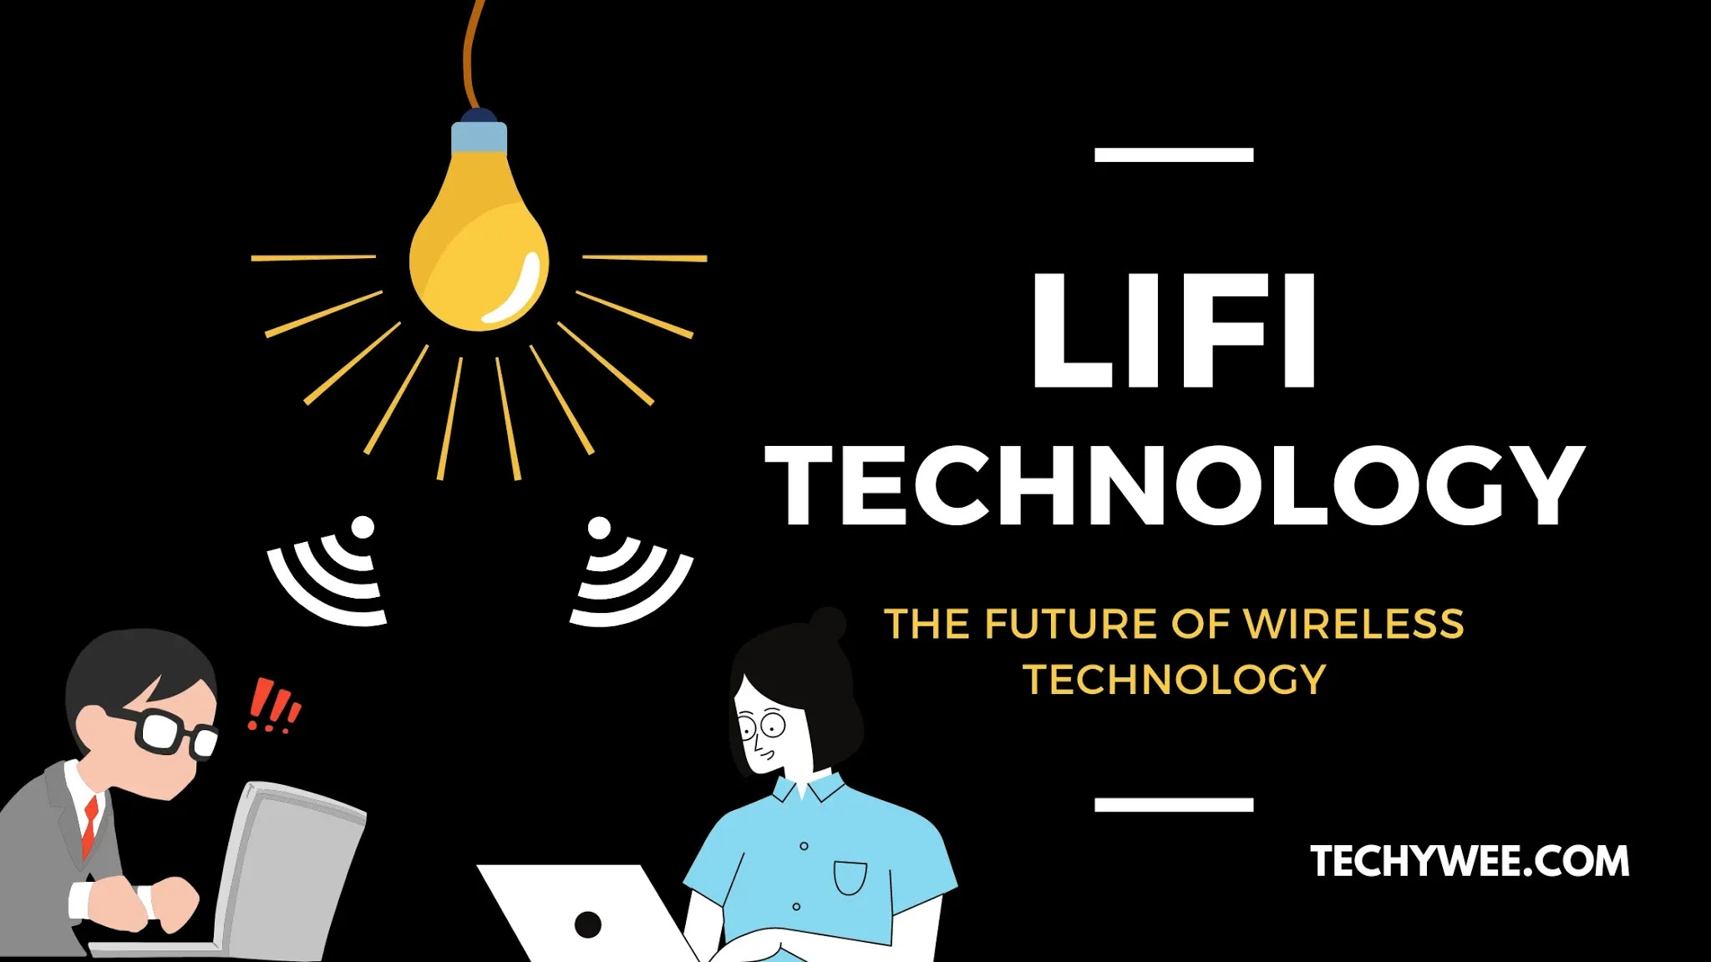

Slide 3
TABLE OF CONTENTS
Introduction of LI-FI
History of LI-FI
Basic Components of LI-FI
How LI-FI Works
Layered Architecture of LI-FI
Modulation Techniques
LI-FI VS WI-FI
Combinations in LI-FI
Advantages and Disadvantages of LI-FI
Uses and Application of LI-FI
Applications of LI-FI
Impacts on Society
Future Scope
Problem Statement
Thesis Statement
Conclusion

Slide 4


Slide 5

INTRODUCTION
Light Based Wi-Fi (Uses light to transmit data)
Based on Visual Light Communication(VLC)
High Speed Network That transport data using visible light
Increases Security, Better bandwidth and efficiency

Slide 6
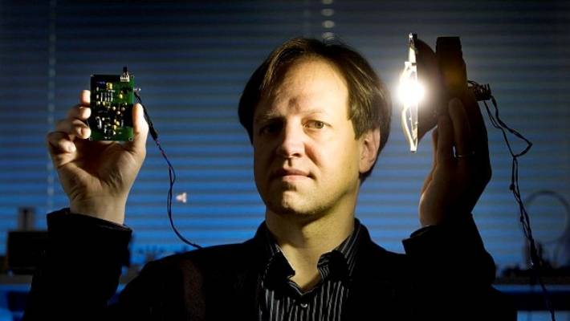
HISTORY OF LI-FI
Introduced by professor Harald Haas
Professor Harald Haas, of the University of Edinburgh in the UK, is widely known as the first founder of Li-Fi
July 2011 at TED global talk conference
Professor Harald Haas named it li-fi. the founder of Pure Li-Fi.

Slide 7

COMPONENTS OF LI-FI
LED (light emitting diode) a semiconductor light source that emits light when current passes through it.
Photodiode used for detecting the data coming from the transmitter side thus acting as a receiver.
Communication channel used for communication in Li-Fi system is the free space

Slide 8

APPLICATIONS/USES OF LI-FI

Slide 9
APPLICATION OF LI-FI
LI-Fi applications are varied as a result of its key features, such as directional lighting, energy efficiency, intrinsic security, high data rate capability, signal blocking by walls and integrated networking capability. Each light fixture in the application environment becomes a separate data channel. These channels can supply different data into each separate pool of light, delivered at the full rated download speed for that channel. Li-Fi will work smoothly on internet applications and for downloading and streaming online content. These applications spot heavy demands on the downlink bandwidth, but need minimum uplink capacity. In this way, the majority of the internet traffic is off-loaded from live RF channels, thus also increase cellular and Wi-Fi capacities. There are many applications for Li-Fi.

Slide 10
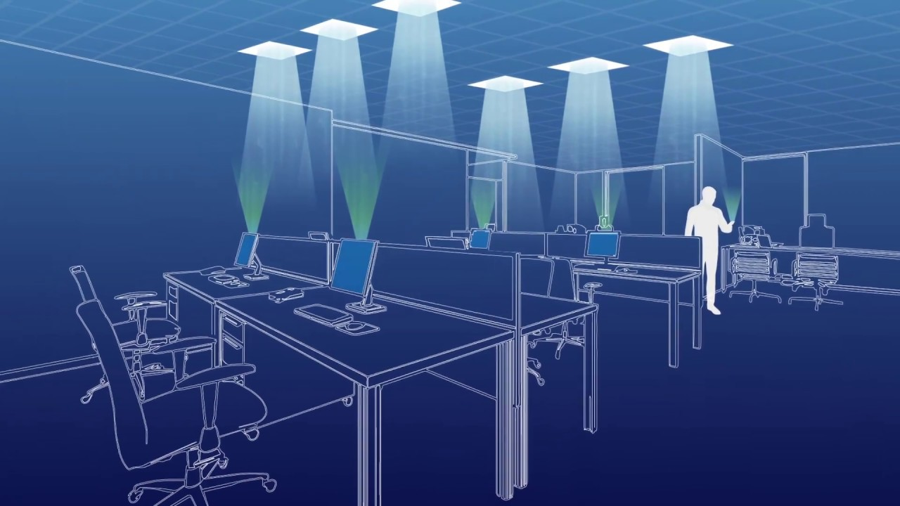
APPLICATION OF LI-FI
Some Application of LI-Fi are as follow:
RF Spectrum Relief
Smart Lighting
Mobile Connectivity
Hazardous Environment
Hospital and HealthCare
Aviation
Underwater Communications
Vehicles and Transportation
Location Based Services
Toys
Education Systems
Traffic Management

Slide 11
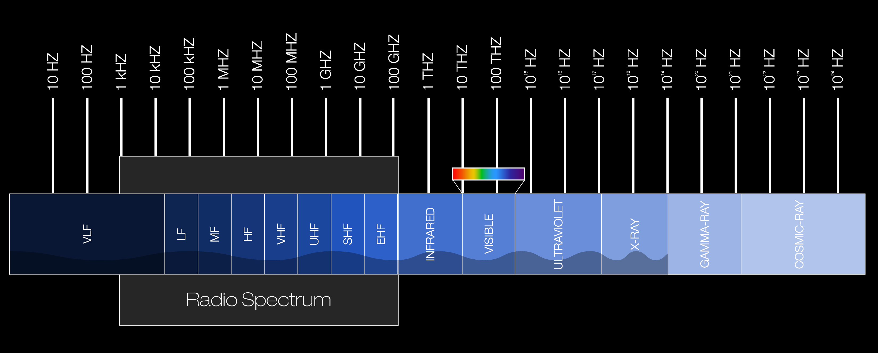
RF SPECTRUM RELIEF
Introduction of RF Spectrum
Purpose of RF Spectrum
How LI-FI gives relief in RF Spectrum?

Slide 12

SMART LIGHTING
Introduction to Smart Lighting
Purpose of Smart Lighting
How LI-FI is uses in Smart Lighting?

Slide 13
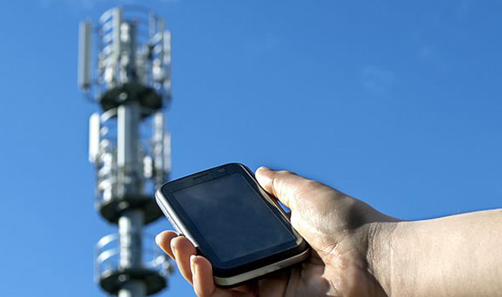
MOBILE CONNECTIVITY
Introduction to Mobile connectivity
Purpose of Mobile connectivity
How LI-FI is uses in Mobile connectivity?

Slide 14

HAZARDOUS ENVIROMENT
Introduction to Hazardous Environment
Purpose of Hazardous Environment
How LI-FI is uses in Hazardous Environment?

Slide 15
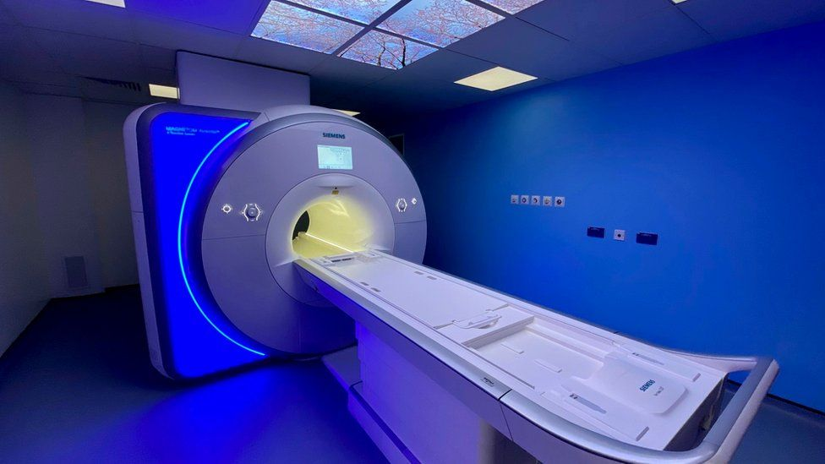
HOSITAL AND HEALTHCARE
Introduction to Hospital and Healthcare
Purpose of Hospital and Healthcare
How LI-FI is uses in Hospital and Healthcare?

Slide 16

AVIATION
Introduction to Aviation
Purpose of Aviation
How LI-FI is uses in Aviation?

Slide 17
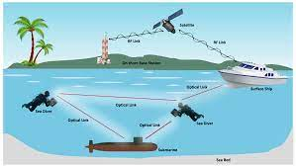
UNDERWATER COMMUNICATION
Introduction to Underwater Communication
Purpose of Underwater Communication
How LI-FI is uses in Underwater Communication?

Slide 18
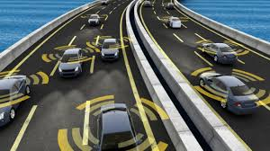
VEHICLES AND TRANSPORTATION
Introduction to Vehicles and Transportation
Purpose of Vehicles and Transportation
How LI-FI is uses in Vehicles and Transportation?

Slide 19

LOCATION BASED SERVICES (LBS)
Introduction to LBS
Purpose of LBS
How LI-FI is uses in LBS?

Slide 20

TOYS
Introduction to Toys
Purpose of Toys
How LI-FI is uses in Toys?

Slide 21

EDUCTAION SYSTEMS
Introduction to Education System
Purpose of Education System
How LI-FI is uses in Education System?

Slide 22
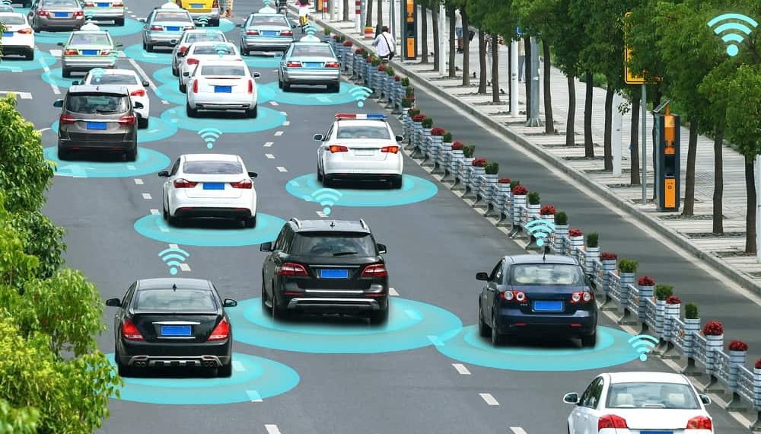
TRAFFIC MANAGEMENT
Introduction to Traffic management
Purpose of Traffic management
How LI-FI is uses in Traffic management?

Slide 23
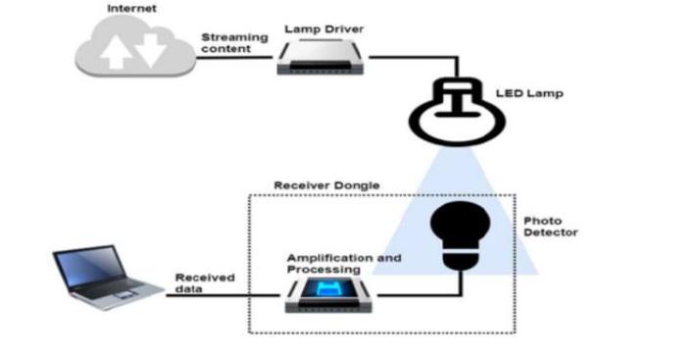
HOW LI-FI WORKS?
Li-Fi technology consist of LED Lamp as the media transmission and photo detector as a receiver of transmitted data. Lamp driver is needed to make LED working properly. While ampLI-Fication and processing are responsible to manage the signal that comes from the photo detector.

Slide 24
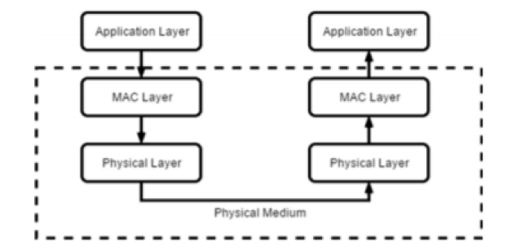
LAYERED ARCHITECTURE OF LI-Fi
In layered architecture, Li-Fi consist of 3 stages that are as follow:
Application layer
MAC layer
Physical Layer

Slide 25
IMPACTS OF LIFI ON SOCEITY
Li-Fi has the power to transform society in many ways. Li-Fi can be used in current infrastructure such as wireless antenna towers. If the world turns to Li-Fi the bulk of the energy produced in fossil fuels can be saved and the current energy crisis will eventually end and the effects on the environment such as pollution caused by the production of fossil fuels will be reduced.

Slide 26
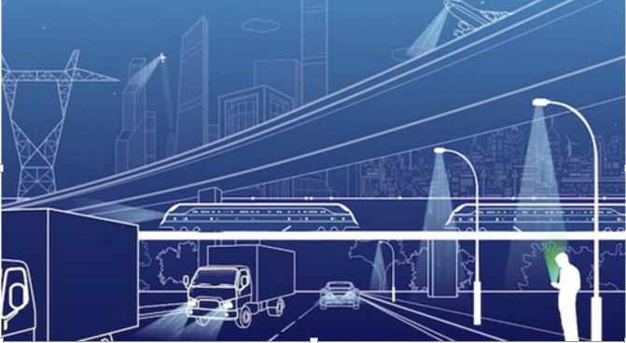
Li-Fi is likely to be available in almost every home and office for the next 20 years. The founder of Li-Fi technology believes that in the next ten years Li-Fi will be more efficient and marketable. If you are not yet able to detect light wavelengths in sequence or a combination of data being transmitted.

Slide 27
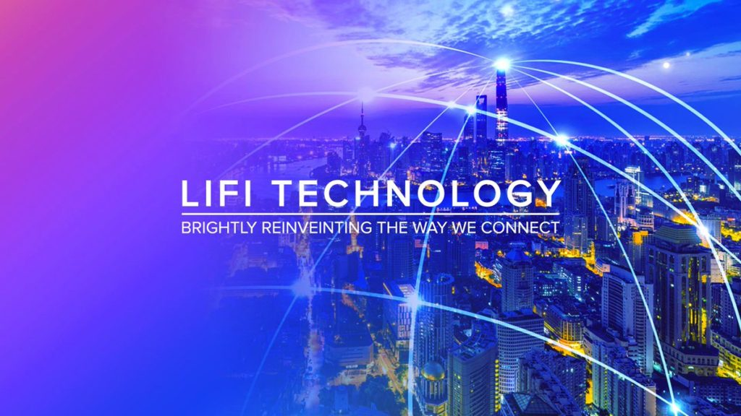
FUTURE SCOPE

Slide 28
Li-Fi has a bright future. More and more companies are working on building Li-Fi products and technology itself is advancing on a daily basis.
It may be that in the future Li-Fi will work with Wi-Fi. Both technologies have their pros and cons and when Li-Fi and Wi-Fi are used together they are compatible.
Some experts say that Li-Fi could be the basis for a single new sector combining the lighting industry and the wireless telecommunications industry.

Slide 29
MODULATION TECHNIQUES
Modulation techniques are generally used when Li-Fi is summarized, and some special issues as well needs are discussed. Some techniques are:
Digital Modulation
Intensity Modulation
Problems on modulations are solved by Hadamard Coded Modulation (HCM) .

Slide 30
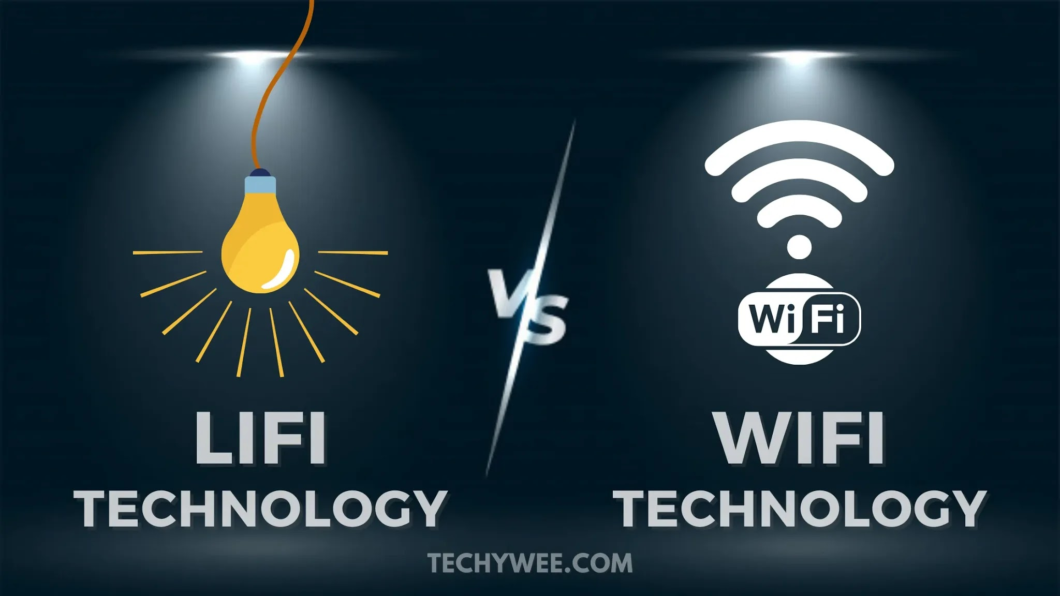
DIFFERENCE BETWEEN LI-FI AND WIFI

Slide 31
LI-FI Vs WI-FI
 | Li-Fi (Light Fidelity) | Wi-Fi (Wireless Fidelity)
Medium | Light (visible light communication ) | Electro-magnetic waves (radio frequency communication )
Technology | optical communication | radio communication
Security | It is secure | Not much secure.
Data Transfer Speed | 500Mbps, up to Gbps, 100Gbps | 11 Mbps
Density of data | High Dense Environment | Low Dense Environment
Frequency Range | 10000 times freq than Wi-Fi | 3 GHZ – 3000 Ghz
Operating frequencies | 100THz | 2.4GHz, 4.9GHz, 5Gz

Slide 32
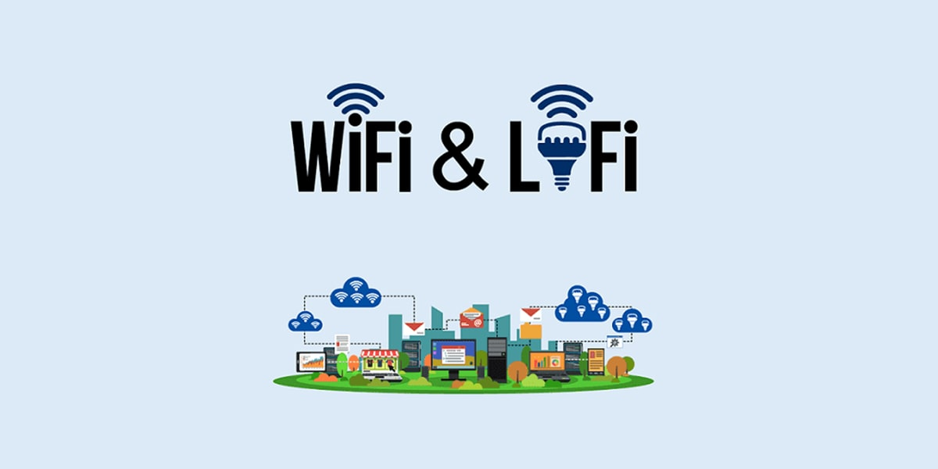
COMBINATION:
Combination of Li-Fi and Wi-Fi is done by two methods that are as follow:
Hybrid Technique
Aggregation Technique

Slide 33
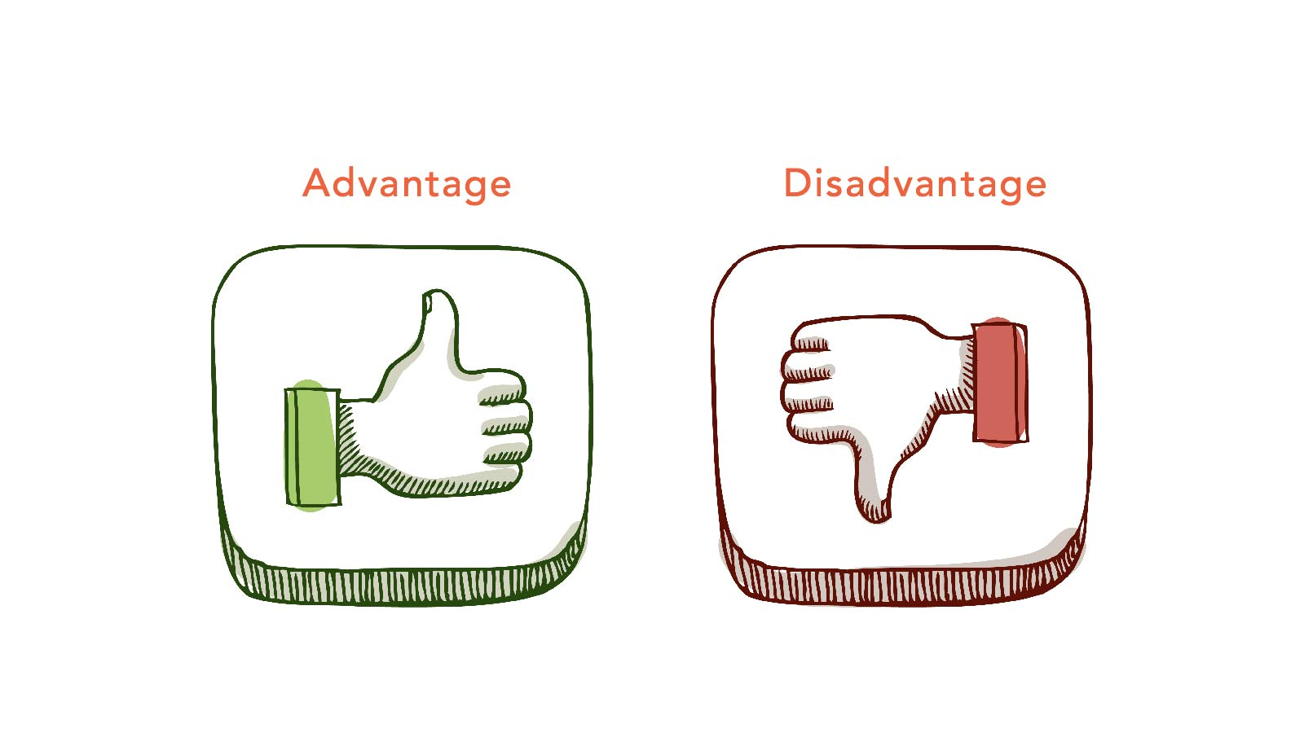
ADVANTGES AND DISADVANTAGES OF LI-FI:

Slide 34
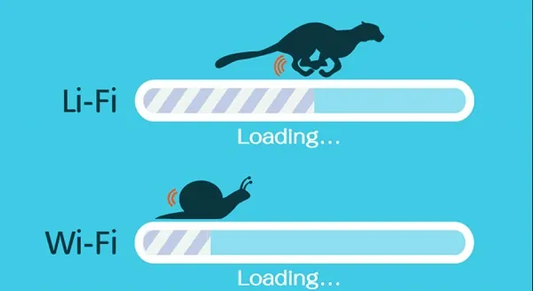
ADVANTAGES OF LI-FI:
Efficiency
Availability
Cheaper
Security
DISADVANTAGES OF LI-FI:.
Affect of other lights in environment
Challenge of receiver to transmitter transmission
Short span of Coverage

Slide 35

PROBLEM STATEMENT
Li-Fi is a technology that has a good perform in an indoor infrastructure while it’s not happen in the outdoor area. The coverage in outdoor area for Li-Fi needs to be set up in order the quality of connection can give a good performance. Li-Fi is integrated with the Wi-Fi to get a good performance in an outdoor or in a mobile infrastructure.
Visible light can’t penetrate through brick walls as radio waves and is easily blocked by somebody simply walking in front of LED source.

Slide 36


Slide 37
Methods to solve the problem statements are:
Their solution includes the selection of Access points to provide Lighter and dense signals. It is more suited for indoor environments.
The other includes the addition of more powerful light.

Slide 38

CONCLUSION
LI-FI may solve issues such as the shortage of radio-frequency bandwidth and is aimed at creating new communication channels with the use of existing equipment. Li-fi has a good performance in the transfer rate, li-fi is not good enough when deploy in an outdoor in sunlight or other condition. This technology may solve issues such as shortage of radio frequency bandwidth and also allow the internet where the traditional radio based wireless isn’t allowed such aircraft and hospitals but li-fi will probably not completely replace wi-fi, these two technologies can be used together to achieve more efficient and secure network.

Slide 39
REFERNECES
https://www.researchgate.net/publication/356489476_A_Review_on_LiFi_Network_Research_Open_Issues_Applications_and_Future_Directions
https://www.academia.edu/56238614/IRJET_LI_FI_TECHNOLOGY_TRANSMISSION_OF_DATA_USING_VISIBLE_LIGHT
https://iarjset.com/wp-content/uploads/2021/03/IARJSET.2021.8220.pdf

